Slide 1

Computer Architecture Project 2
Group members and marks-
Uday Teja Bandaru (utb220000)
Dibyanshi Singh (dxs210139)
100/100

Slide 2
Branch Prediction
Technique that guesses the outcome of the conditional operation.
Prepares for the most likely result.
If at runtime, guess is incorrect, CPU executes other branch operation.
If guess incorrect another operation is executed with slight delay.
Else accuracy is increased significantly.
Accuracy becomes better with time.

Slide 3
Importance of Branch Prediction
If the branch prediction is accurate, it allows execution of instruction on predicted path that results in improved instruction throughput and allows performance gains.
It enable instruction level parallelism that allows instructions to be executed simultaneously by executing instructions from both predicted branch path and sequential branch path. Therefore, it improves resources utilization.
Branch prediction also follows speculative execution where a processor executes instructions ahead of their need( based on predicted outcomes). This maximizes performance as the processor is busy with work
Lastly, by dynamic branch prediction historical branch patterns are analyzed and noted. These statistics help to make accurate predictions

Slide 4
Three types of Branch Predictors
1.Bimodal Predictor-
Uses a single bit of memory to predict the outcome of the branch
Easy implementation
Low hardware overhead
Limited accuracy

Slide 5
2.Two-bit Local Predictor
Uses larger amount of data(history) to predict the outcome
Maintains a table of history and their respective outcomes and uses them to predict the outcome
Higher accuracy than bimodal
Require most hardware resources
Highest implementation complexity

Slide 6
3. Tournament Predictor
Combines both bimodal and two-bit local predictor.
Selects more accurate predictor for each branch.
Uses a small chooser table that selects accurate predictor based on the past performances.
Provides the best accuracy out of the three predictors.
Requires most hardware resources.
Has highest implementation complexity.

Slide 7
Tradeoffs-
Criteria | Bimodal Branch Predictor | Local 2-bit Branch Predictor | Tournament Branch Predictor
Accuracy | Least accurate | More accuracy than Bimodal | Most accurate
Hardware overhead | Least requirement of hardware resources | More requirement of hardware resources than Bimodal | Most requirement of hardware resources
Implementation Complexity | Simplest | More complex | Most complex

Slide 8
Summarize how you made gem5 work and problems found and how you resolved them if any?

Slide 9
In proj_1, our automation script is sequential and takes long time, this time in automation scripts, each time gem5 is built, we had run the benchmarks parallelly with multiple instances of gem5.opt. and automated the size changes to be made in the src code within the script
Tried to build the gem5 and run benchmarks in engnx.utdallas.edu linux "no machine" setup, to reduce to the compilation times to half, but since necessary libraries are not installed and can't use sudo, had to use ce6304.utdallas.edu server machine, personal laptops for compilations, just how it was done in proj1.

Slide 10
Describe changes made to specify the different branch predictors (where in gem5)

Slide 11
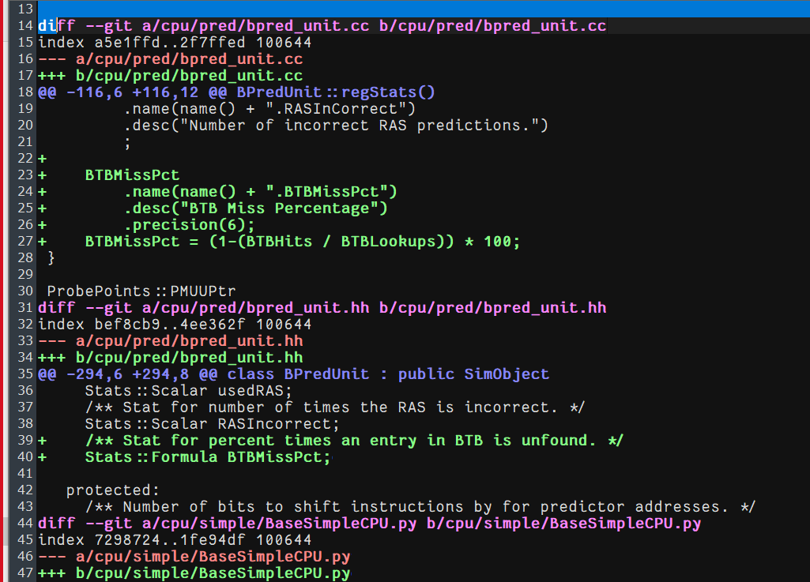
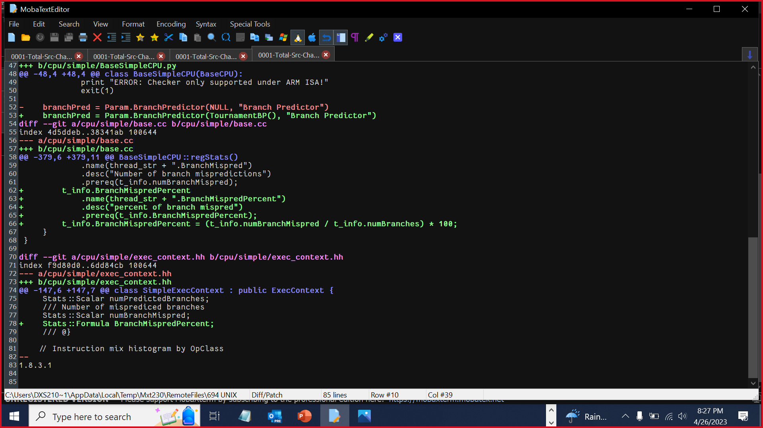
We used git to keep track of changes and made commits for src code changes.

Slide 12
Show the result of your config.ini file which shows the TournamentBP.

Slide 13
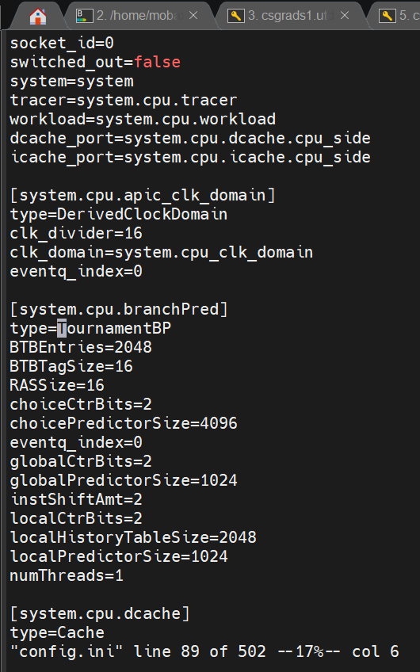
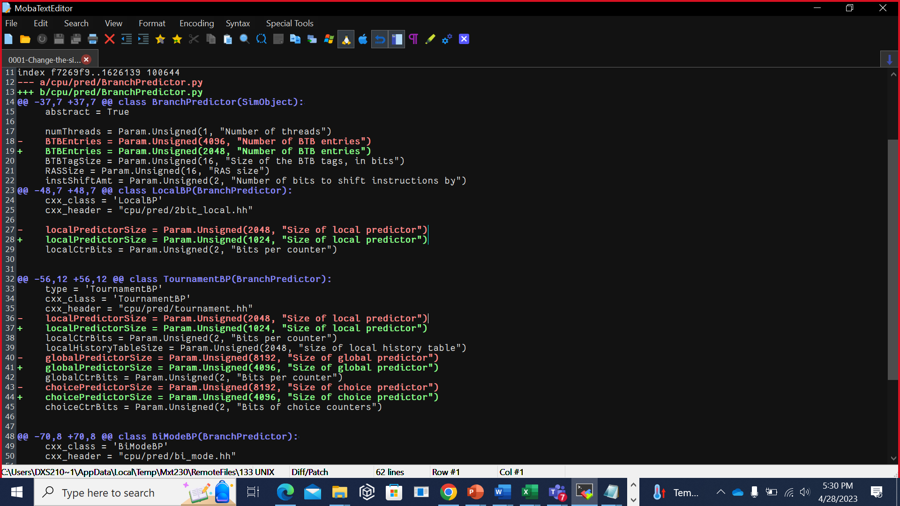

Slide 14
Show the results obtained when using different branch predictors and compare all 3 of them.

Slide 15

401.bzip2
Branch_predictors | _BTBMisspct | _BranchMispredprc | Weighted Average
TournamentBP | 0.137101 | 5.957611 | 1.224298267
LocalBP | 0.180559 | 6.423041 | 0.862263822
BiModeBP | 0.135964 | 5.861122 | 1.254860086
We are assuming that

Slide 16
429.mcf
Branch_predictors | _BTBMisspct | _BranchMispredprc | Weighted Average
TournamentBP | 4.638237 | 4.97113 | 0.04337
LocalBP | 8.522339 | 10.201319 | 0.011502
BiModeBP | 2.502668 | 5.637332 | 0.07088

Slide 17
456.hmmer
Branch_predictors | _BTBMisspct | _BranchMispredprc | Weighted Average
TournamentBP | 1.076381 | 9.414638 | 0.098680275
LocalBP | 2.484624 | 14.405269 | 0.027939456
BiModeBP | 0.837032 | 10.591725 | 0.112795362

Slide 18
458.sjeng
Branch_predictors | _BTBMisspct | _BranchMispredprc | Weighted Avg
TournamentBP | 4.779572 | 9.794787 | 0.021360725
LocalBP | 9.301345 | 14.386075 | 0.007473292
BiModeBP | 7.102563 | 10.217297 | 0.01377999

Slide 19
470.lbm
Branch_predictors | _BTBMisspct | _BranchMispredprc | Weighted Average
TournamentBP | 46.465237 | 0.648239 | 0.033199893
LocalBP | 22.490235 | 0.595286 | 0.074693075
BiModeBP | 0.145697 | 0.81194 | 8.453283869

Slide 20
Insights
The branch misprediction percentage represents the rate at which the branch predictor makes incorrect predictions.
The BTB miss percentage reflects the rate at which the branch target is not found in the Branch Target Buffer.
The weighted average combines multiple metrics to provide an overall assessment of the branch predictor's performance.
The Tournament branch predictor and BiMode branch predictor have higher weighted averages compared to the Local branch predictor. This suggests that the Tournament and BiMode predictors exhibit better overall performance based on the given weighting scheme.
The Tournament branch predictor seems to have the lowest branch misprediction percentage, followed by the BiMode predictor, while the Local branch predictor has the highest misprediction percentage.
The Tournament predictor also has the lowest BTB miss percentage, indicating better utilization of the Branch Target Buffer.

Slide 21
Report how varying the size of the predictor affects the BTB miss and Branch prediction miss for the 5 different benchmarks.

Slide 22
TrnBP_401.bzip2_

Slide 23
TrnBP_429.mcf_

Slide 24
TrnBP_456.hmmer

Slide 25
TrnBP_458.sjeng_

Slide 26
TrnBP_470.lbm

Slide 27
Insights from the graph
Overall, increasing the size of the predictor tends to decrease both the BTB miss and branch prediction miss rates. This is likely because larger predictors can store more information about past branch behavior, allowing for more accurate predictions.
The relationship between predictor size and miss rates is not linear. For example, increasing the size of the local and global predictors from 1024 to 2048 reduces the BTB miss rate, but increasing them further to 4096 causes the BTB miss rate to rise again.
This suggests that there may be diminishing returns to increasing the predictor size beyond a certain point, as the additional information stored in the predictor becomes less relevant or useful for improving prediction accuracy.
The data indicates that increasing the size of the predictor can improve branch prediction accuracy, but the relationship between predictor size and miss rates is complex and nonlinear.

Slide 28

Thank You

